Slide 1
Using pandas to get started with ALT2
A presentation for LCCS teachers
by Joe English (PDST)
Spring 2021 CoP/Clusters
Notes:
statistics
re
matplotlib
pandas

Slide 2

Applied Learning Task 2
Hypothesis vs. Dataset

Slide 3
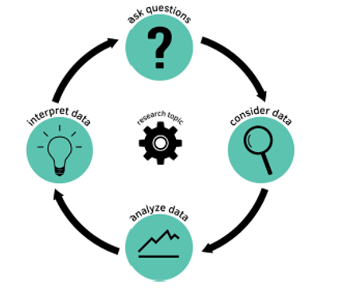
The Data Cycle
A framework for ALT2

Slide 4











Data Sets

Slide 5

Searchable repository of user-generated datasets (and data challenges)
Detailed and user-friendly search function
Free courses on Python, Machine Learning, Pandas, SQL, etc.
We will explore a FIFA 21 player dataset
Notes:
Search Ireland, refine by datasets, csv, small, last week.

Slide 6
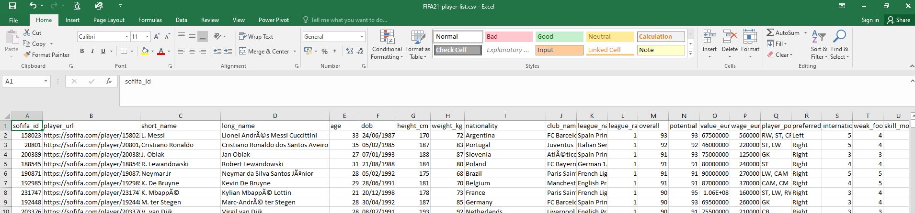
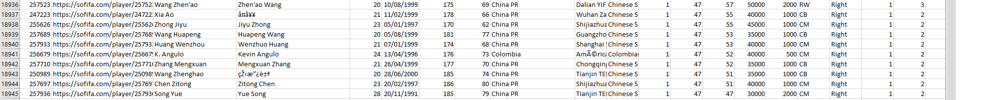
Fifa 21 player dataset
Source: https://www.kaggle.com/stefanoleone992/fifa-21-complete-player-dataset
Notes:
Other ideas ….
Could graph player value vs. age – older players are more valuable than younger ones
Could graph player value vs. foot – left footed players are more valuable than right footed players
Could graph player value vs. position – forwards are the most valuable players
Could graph player value vs. position – forwards are more valuable than defenders
Could graph player value vs. position – players who can play in multiple positions are more valuable than those who can just play in one position

Slide 7

Pandas
Many popular Python libraries:
  NumPy http://www.numpy.org/
  SciPy https://www.scipy.org/scipylib/
  Pandas http://pandas.pydata.org/
  SciKit-Learn http://scikit-learn.org/
Visualisation libraries
  matplotlib https://matplotlib.org/
  Seaborn https://seaborn.pydata.org/
pandas will help you to explore, clean and process your data
Notes:
NumPy:
introduces objects for multidimensional arrays and matrices, as well as functions that allow to easily perform advanced mathematical and statistical operations on those objects
provides vectorization of mathematical operations on arrays and matrices which significantly improves the performance
many other python libraries are built on NumPy
SciPy:
collection of algorithms for linear algebra, differential equations, numerical integration, optimization, statistics and more
Pandas:
adds data structures and tools designed to work with table-like data (similar to Series and Data Frames in R)
provides tools for data manipulation: reshaping, merging, sorting, slicing, aggregation etc.
allows handling missing data
SciKit-Learn:
provides machine learning algorithms: classification, regression, clustering, model validation etc.
built on NumPy, SciPy and matplotlib
matplotlib:
python 2D plotting library which produces publication quality figures in a variety of hardcopy formats
a set of functionalities similar to those of MATLAB
line plots, scatter plots, barcharts, histograms, pie charts etc.
relatively low-level; some effort needed to create advanced visualization
Seaborn:
based on matplotlib
provides high level interface for drawing attractive statistical graphics

Slide 8
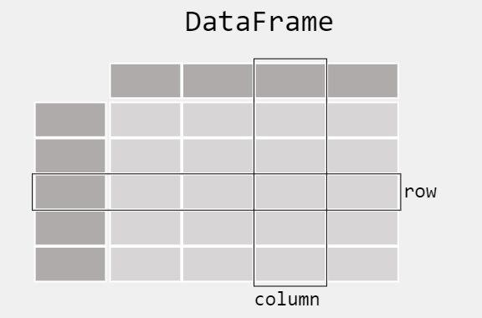

What kind of data does pandas handle?
Each column is called a Series
In pandas, a data table is called a DataFrame

Slide 9
Pandas – reading in a CSV file
# Using pandas - recommended for larger files
import pandas
# Read the entire CSV file into a pandas DataFrame
fifa_df = pandas.read_csv('FIFA21-player-list.csv')
# Display the length of the dataframe
print("Nr. rows", len(fifa_df))
# Display the number of rows and column
print("Shape (rows, cols)", fifa_df.shape)
Output looks like this:
Nr. rows 18944
Shape (rows, cols) (18944, 106)
Notes:
There are a number of pandas commands to read other data formats including MS Excel
pd.read_excel('myfile.xlsx',sheet_name='Sheet1', index_col=None, na_values=['NA'])

Slide 10
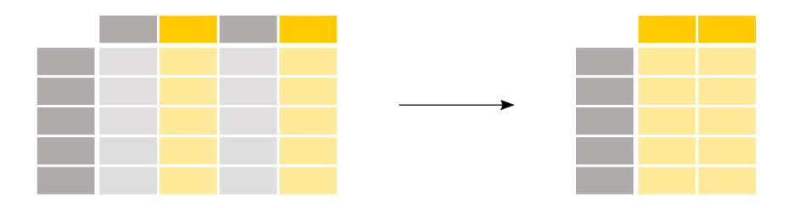
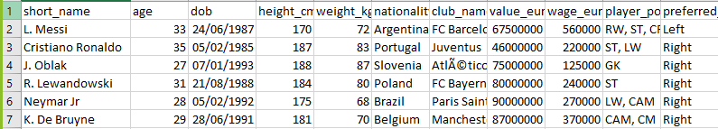
Pandas – selecting specific columns from a DataFrame
We may only be interested in the player’s name, age and value

Slide 11
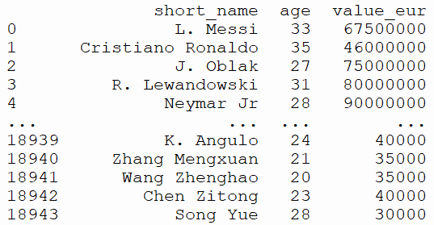
Pandas
# Using pandas - recommended for larger files
import pandas
# Read the entire CSV file into a pandas DataFrame
fifa_df = pandas.read_csv('FIFA21-player-list.csv')
# Select a number of columns - all rows
fifa_df1 = fifa_df[['short_name', 'age', 'value_eur']]
print(fifa_df1) # DataFrame
Output looks like this:
# Select a single column - all rows
values = fifa_df['value_eur']

Slide 12

Pandas – selecting specific rows from a DataFrame
We may only be interested in players that meet certain criteria

Slide 13
Pandas – selecting specific rows from a DataFrame
We may only be interested in players that meet certain criteria

Slide 14
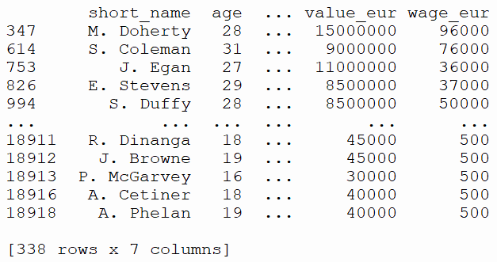
Filter by nationality
irish_players = fifa_df1[fifa_df1['nationality'] == 'Republic of Ireland']
print(irish_players)
Output looks like this:
Any Boolean operator can be used to subset the data:
> greater; >= greater or equal;
< less; <= less or equal;
== equal; != not equal;

Slide 15
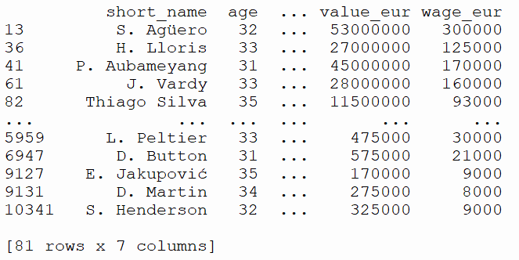
Premier league players over 30
prem_players_over_30 = fifa_df1[(fifa_df1['league_name'] == 'English Premier League') & (fifa_df1['age'] > 30)]
print(prem_players_over_30)
Output looks like this:
Can combine Boolean expressions
& and
| or
~ not
Notes:
Ou

Slide 16

Pandas – selecting specific rows and columns from a DataFrame
We may only be interested in seeing the player names of players over 30

Slide 17
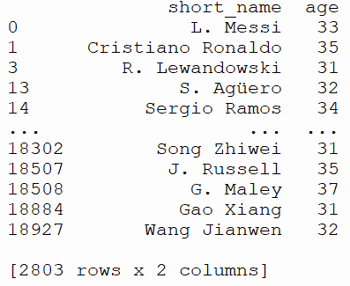
Filter by row and column
players_over_30 = fifa_df1.loc[(fifa_df1['age'] > 30), ['short_name', 'age']]
print(players_over_30)
Output looks like this:
The loc operator is required in front of the selection brackets, [].
When using loc the part before the comma is the rows you want, and the part after the comma is the columns you want to select.
In this example we want:
all the rows where the age is greater than 30 and
all the short_name and age columns
Notes:
Summary
When selecting subsets of data, square brackets [] are used.
Inside these brackets, you can use a single column/row label, a list of column/row labels, a slice of labels, a conditional expression or a colon.
Select specific rows and/or columns using loc when using the row and column names
Select specific rows and/or columns using iloc when using the positions in the table
You can assign new values to a selection based on loc/iloc.

Slide 18
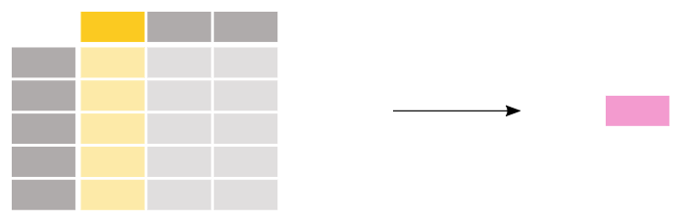
Aggregrating Data
Available methods:
value_counts()
max(), min()
mean(), median()
describe()
Plus more …

Slide 19
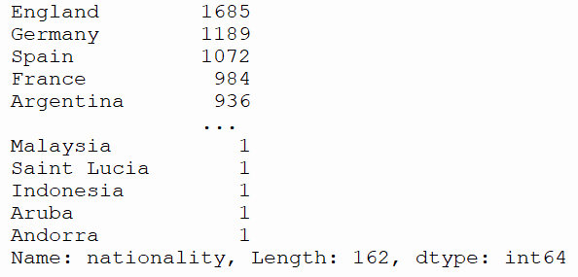
Count players by nationality
fifa_df1 = fifa_df[['short_name', 'age', 'nationality', 'club_name', 'league_name', 'value_eur', 'wage_eur']]
nationality_counts = fifa_df1['nationality'].value_counts()
print(nationality_counts)
Output looks like this:
value_counts counts the number of entries in each category of a variable

Slide 20
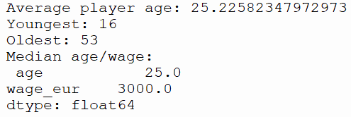
Minumum, Maximum and Averages
fifa_df1 = fifa_df[['short_name', 'age', 'nationality', 'club_name', 'league_name', 'value_eur', 'wage_eur']]
# What is the average player age?
print("Average player age:", fifa_df1['age'].mean())
# What are the youngest and oldest ages
print("Youngest:", fifa_df1['age'].min())
print("Oldest:", fifa_df1['age'].max())
# What is the median age and wage of a player?
print("Median age/wage:\n", fifa_df1[['age', 'wage_eur']].median())
Output looks like this:

Slide 21
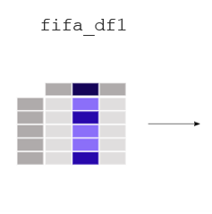
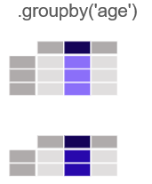
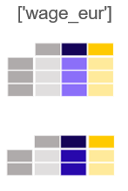
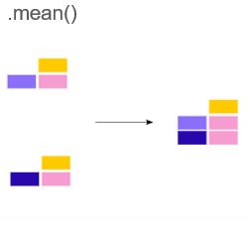
Grouping Data
Let’s say we wanted to see the average wages by player age
fifa_df1 = fifa_df[['short_name', 'age', 'nationality', 'club_name', 'league_name', 'value_eur', 'wage_eur']]
# Player wage grouped by age?
print(fifa_df1.groupby('age')['wage_eur'].mean())

Slide 22
Grouping Data
Output
age wage_eur
16 601.724138
17 785.897436
18 1196.257485
19 2322.093023
20 4029.747722
21 4380.477223
22 6550.801394
23 7712.287848
24 8726.177091
25 10458.400000
26 11415.700861
27 11755.464256
28 13551.255887
29 13197.990431
30 11645.508021
31 12352.929688
…
43 2750.000000
53 850.000000

Slide 23
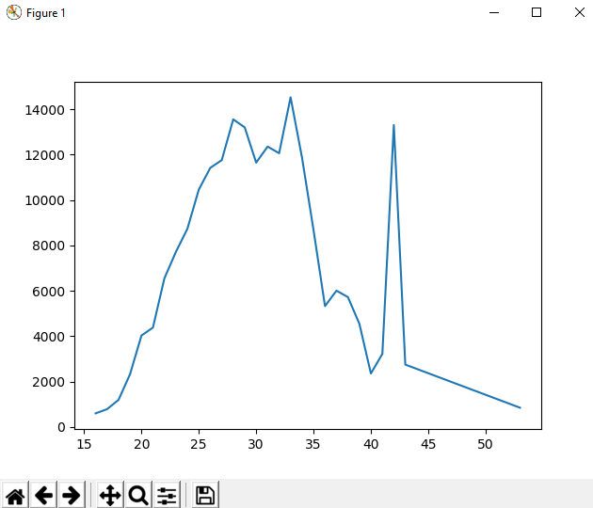
Plotting grouped data …
from matplotlib import pyplot
# Player wage grouped by age
df = fifa_df1.groupby('age')['wage_eur'].mean()
print(df)
pyplot.plot(df)
pyplot.show()
Output
age wage_eur
16 601.724138
17 785.897436
18 1196.257485
19 2322.093023
20 4029.747722
21 4380.477223
22 6550.801394
23 7712.287848
24 8726.177091
25 10458.400000
26 11415.700861
27 11755.464256
28 13551.255887
29 13197.990431
30 11645.508021
31 12352.929688
…
43 2750.000000
53 850.000000

Slide 24
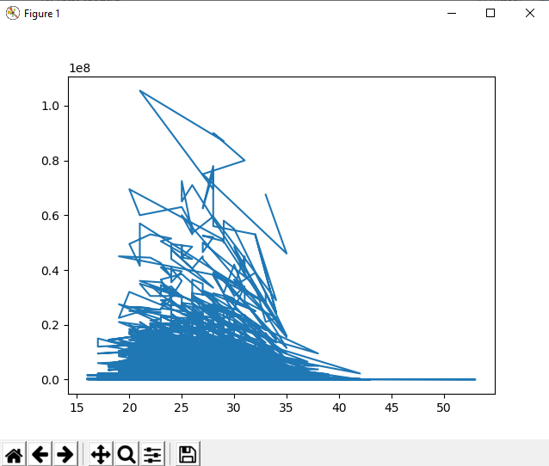
Attempt #1
# Using pandas - recommended for larger files
import pandas
from matplotlib import pyplot
# Read the entire CSV file into a pandas DataFrame
df = pandas.read_csv('FIFA21-player-list.csv')
# Filter out the column, value_eur
player_values = df['value_eur']
player_ages = df['age']
pyplot.plot(player_ages, player_values)
pyplot.show()

Slide 25
Player wage by league
print(fifa_df1.groupby(['league_name'])['wage_eur'].mean())
league_name
Argentina Primera División 6421.547800
Argentinian Primera B Nacional 500.000000
Australian Hyundai A-League 1594.000000
Austrian Football Bundesliga 5522.258065
Belgian Jupiler Pro League 6365.650407
Campeonato Brasileiro Série A 9341.666667
Chilian Campeonato Nacional 1020.402299
Chinese Super League 5294.724771
Colombian Liga Postobón 1007.179487
Croatian Prva HNL 500.000000
Czech Republic Gambrinus Liga 500.000000
Danish Superliga 4457.704918
Ecuadorian Serie A 500.000000
English League Championship 9866.361072
English League One 2133.571429
English League Two 2207.024793
English Premier League 52149.082569
Finnish Veikkausliiga 500.000000
French Ligue 1 19445.583333
French Ligue 2 2111.080586
German 1. Bundesliga 24073.996350
German 2. Bundesliga 5720.611440
German 3. Bundesliga 1285.153257
Greek Super League 500.000000
Holland Eredivisie 4582.618026
Italian Serie A 27602.945736
Italian Serie B 500.000000
Japanese J. League Division 1 2773.416507
Output looks like this:

Slide 26
Player wage by nationality and age
print(fifa_df1.groupby(['nationality', 'age'])['wage_eur'].mean().head(20))
Output looks like this:
nationality age
Afghanistan 22 2000.000000
28 1000.000000
Albania 18 900.000000
19 1000.000000
20 5371.428571
21 1500.000000
22 2000.000000
23 16625.000000
24 1950.000000
25 30000.000000
26 15250.000000
27 22500.000000
28 5750.000000
29 8200.000000
30 7333.333333
31 500.000000
32 950.000000
34 4000.000000
Algeria 20 9000.000000
22 13500.000000
Name: wage_eur, dtype: float64

Slide 27

Data Science – One Definition

Slide 28


© PDST 2021
Notes:
End of session

